Slide 1
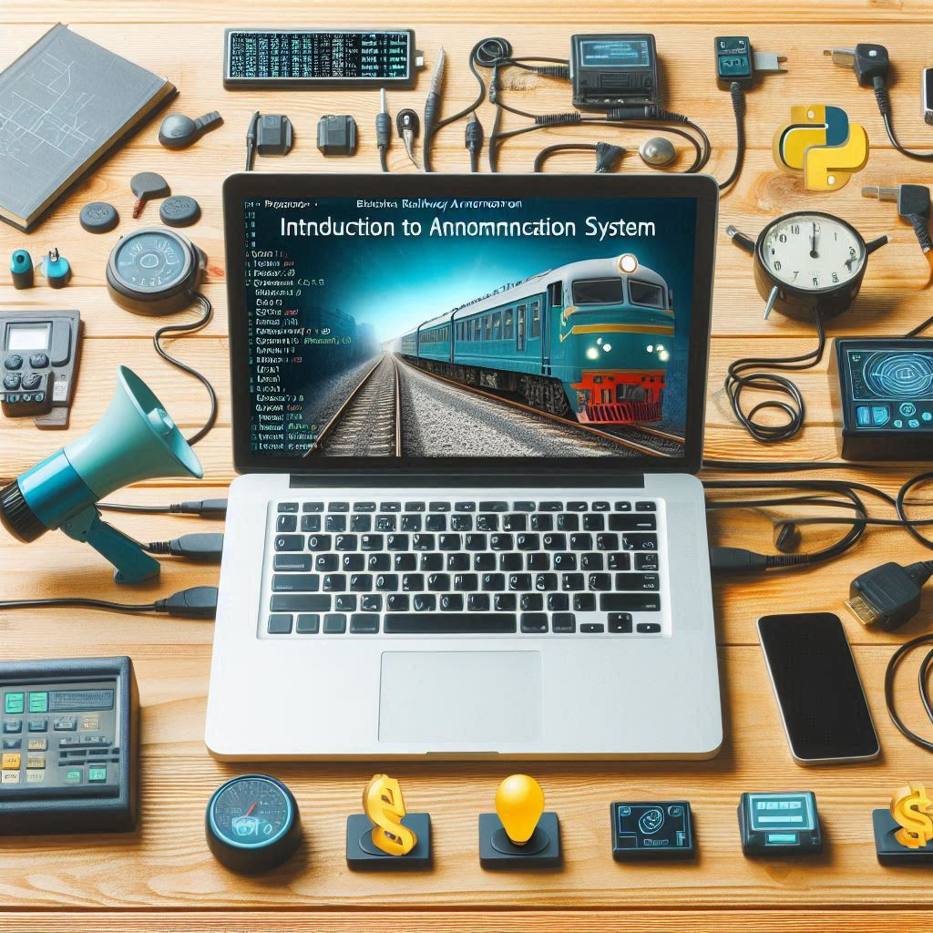
INTRODUCTION
This project is about creating a Railway Announcement System using Python programming. The system is designed to automate the process of making announcements at railway stations, ensuring that information about train arrivals, departures, and platforms is delivered clearly and accurately.

Slide 2
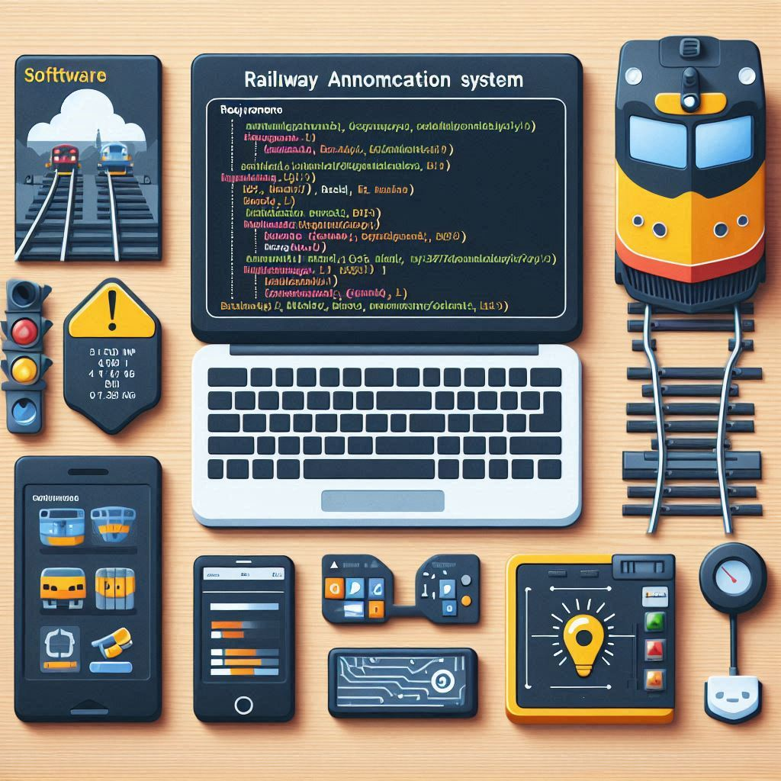
SOFTWARE REQUIREMENTS
Python 3.x: The core programming language used to build the application.
Pandas: A data manipulation and analysis library, used here for handling the Excel sheet containing train data.
Pydub: A library used for audio processing, including merging and exporting audio files.
GTTS (Google Text-to-Speech): A library for converting text to speech in various languages.

Slide 3
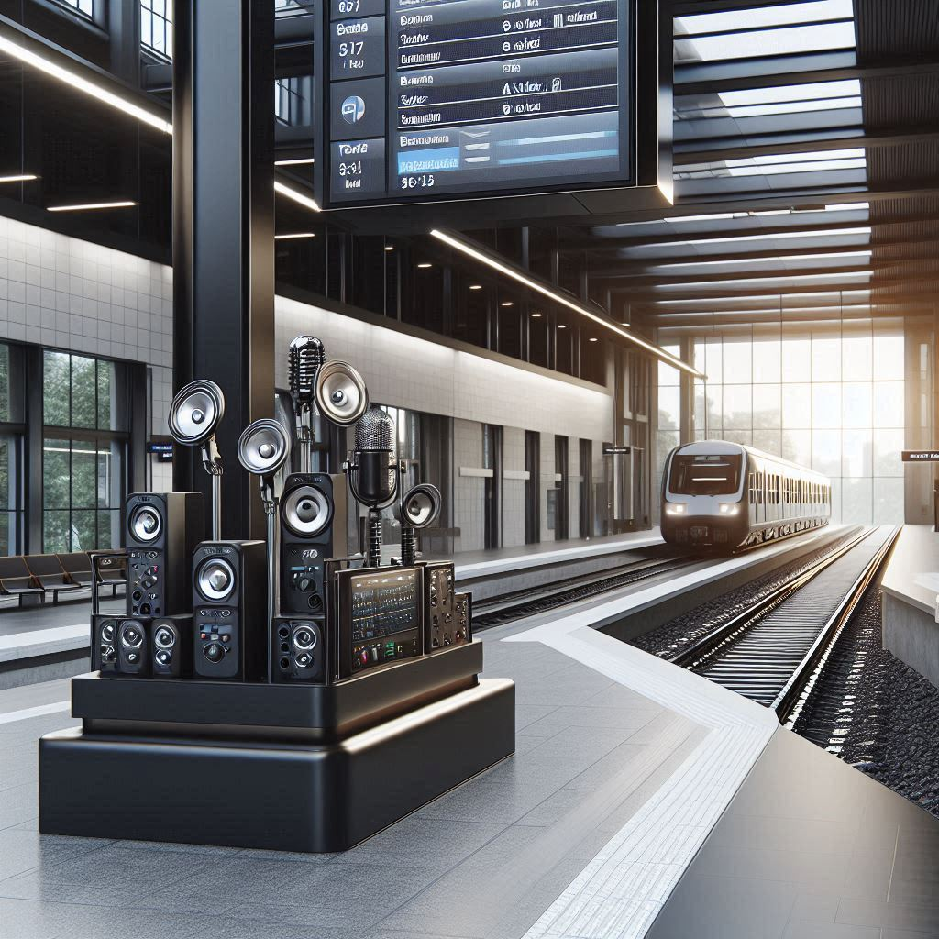
HARDWARE REQUIREMENTS
Laptop: The primary hardware for writing, testing, and running Python code.
Speakers: For outputting the generated announcements, ensuring they are audible in the railway station.
Microphone: (Optional) Could be used for recording audio clips or voice inputs in future enhancements.

Slide 4
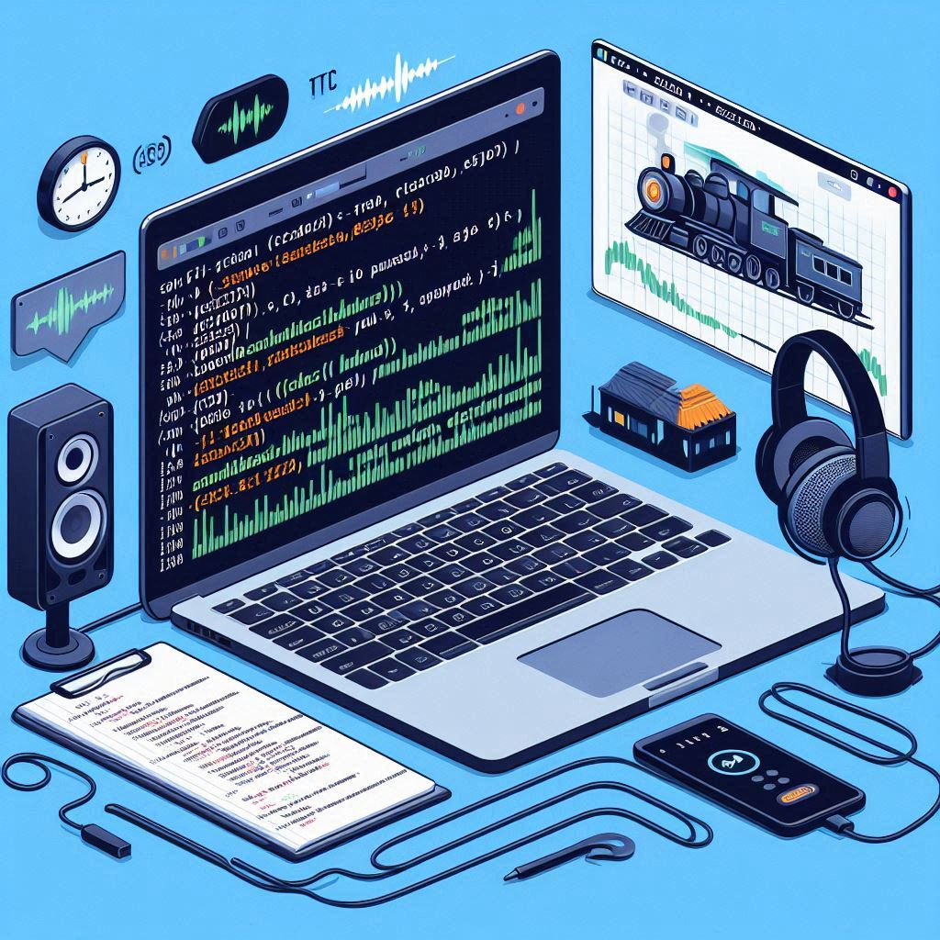
TECHNOLOGY USED
Laptop: Used for coding, running the Python scripts, and managing data and audio files.
VS Code: A versatile and powerful code editor that supports multiple programming languages and tools, making it ideal for Python development.
Pandas: This library is used to read and manipulate train data from an Excel file.
pydub: Used for processing audio segments, allowing the project to cut, merge, and export audio clips efficiently.
gTTS (Google Text-to-Speech): A key component for converting textual train information into speech.
AudioSegment: A class from the pydub library that handles audio data, enabling the merging of various audio segments into a cohesive announcement.

Slide 5

IMPLEMENTATIONS
Excel File Handling: The project utilizes an Excel file to store and manage train data, including the train number, name, source, destination, and platform number.
Text-to-Speech Conversion: The textToSpeech() function converts textual information from the Excel file into speech. The generated speech is saved as an MP3 file, which is later used in the final announcement.
Audio Processing: The generateSkeleton() function extracts specific segments from a base audio file (railway.mp3) to create reusable audio clips, such as "Kripaya dhyan dijiye," "se chalkar," and "par aa rhi hai." These clips form the framework for the announcement.
Announcement Generation: The generateAnnouncement() function reads the Excel file, converts relevant details into speech using the textToSpeech() function, and merges the generated audio files using pydub to create the final announcement.
Exporting the Announcement: Finally, the merged audio is exported as an MP3 file, ready to be played at the railway station.

Slide 6
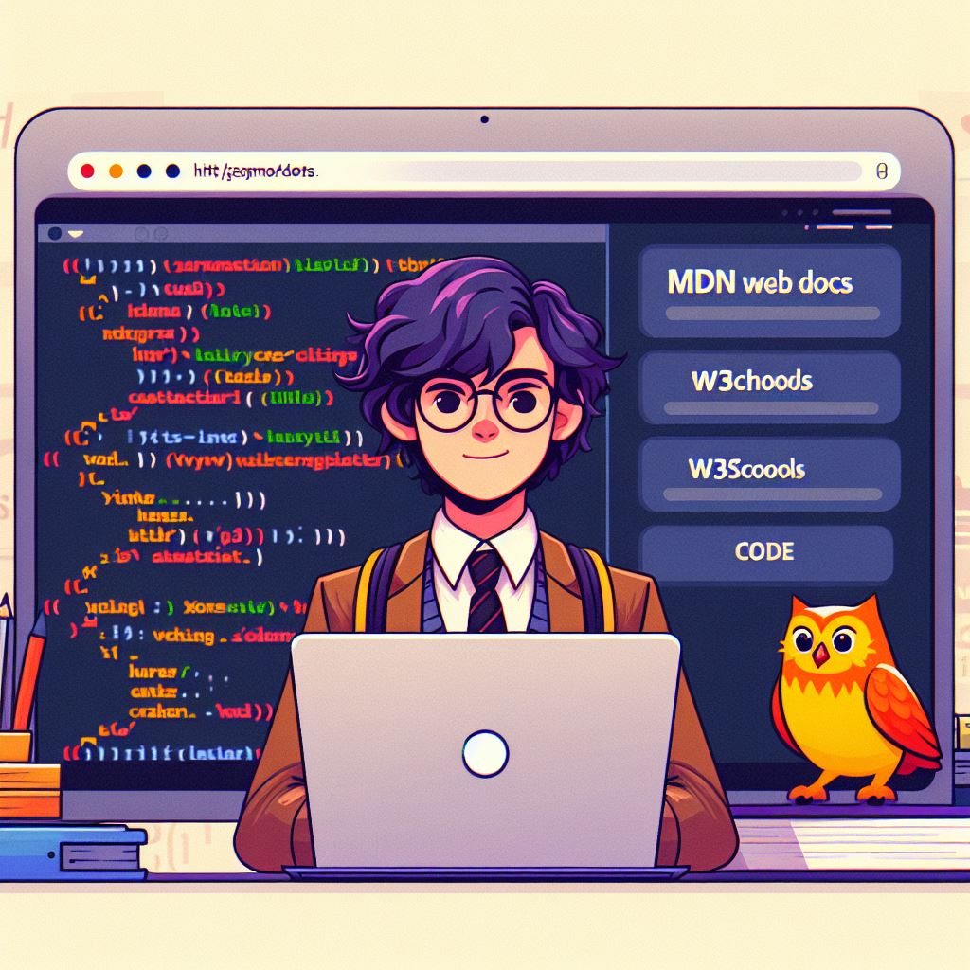
REFERENCES
Code with Harry: The project is inspired by and references tutorials and resources from "Code with Harry," a popular educational platform for programming and software development.
Pandas Documentation: Official documentation for the Pandas library used for data manipulation.
pydub Documentation: Official documentation for the pydub library used for audio processing.
gTTS Documentation: Official documentation for the Google Text-to-Speech library used for converting text to speech.
Python Documentation: General documentation for Python programming language.

Slide 7

CONCLUSION
The Railway Announcement System project effectively demonstrates how Python can be used to automate and improve the announcement process at railway stations. By replacing manual announcements with a system that generates clear and accurate messages automatically, this project not only saves time but also reduces the possibility of human error. The use of VS Code as the development environment and references from "Code with Harry" further illustrate the accessibility and practicality of this project. The scalability of the system allows it to be easily adapted for different languages and locations, making it a valuable tool for modernizing railway operations.

Slide 8

OUTPUT

Slide 9

ABOUT US
We are a group of second-year students from Thakur College of Science and Commerce, pursuing a Bachelor’s in Information Technology (SYIT-B). Our team includes:
Anurag Pandey(4116)
Aryan Yadav 4119)
Akash Pathak(4120)
Nilesh Safi Yadav(4118)
Vishal Tiwari (4117)

Slide 10
THANKS
We would like to extend our heartfelt thanks to Mrs. Rimsy Dua, our class teacher, for her unwavering support and guidance. Your dedication and encouragement have been instrumental in our learning journey and have greatly contributed to our success.
Thank you for believing in us and for providing us with the tools and inspiration to achieve our goals. Your impact on our academic and personal growth is deeply appreciated.
With gratitude, The SYIT-B Team

